Slide 1


Observations Seminar
Zonally Asummetric Response of the Southern Ocean Mixed-Layer Depth to the Southern Annular Mode

Slide 2
What is SAM

Slide 3
How does SAM affect weather
SAM is dominant mode of climate variability in southern ocean
Positive SAM strengthens westerlies, changes EKE and SST
http://www.abc.net.au/news/2018-08-14/southern-annular-mode/10119858

Slide 4
How Does SAM affect MLD??

Slide 5
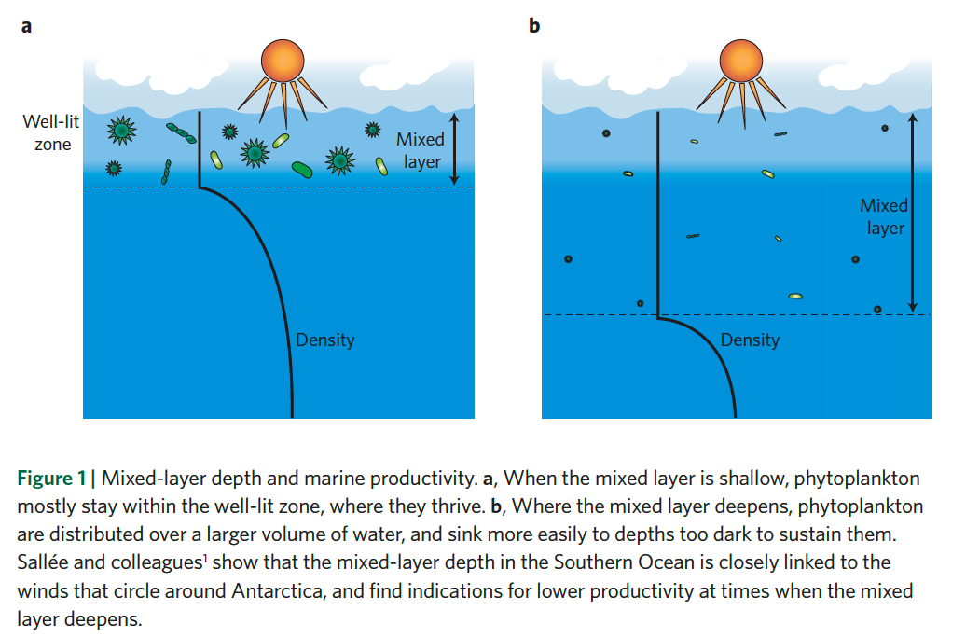
Why is this important??
Ventilation of nutrients, fresh water, and heat throughout the ocean..
Carbon exchange (upwelling and outgassing)
Net Community Production

Slide 6
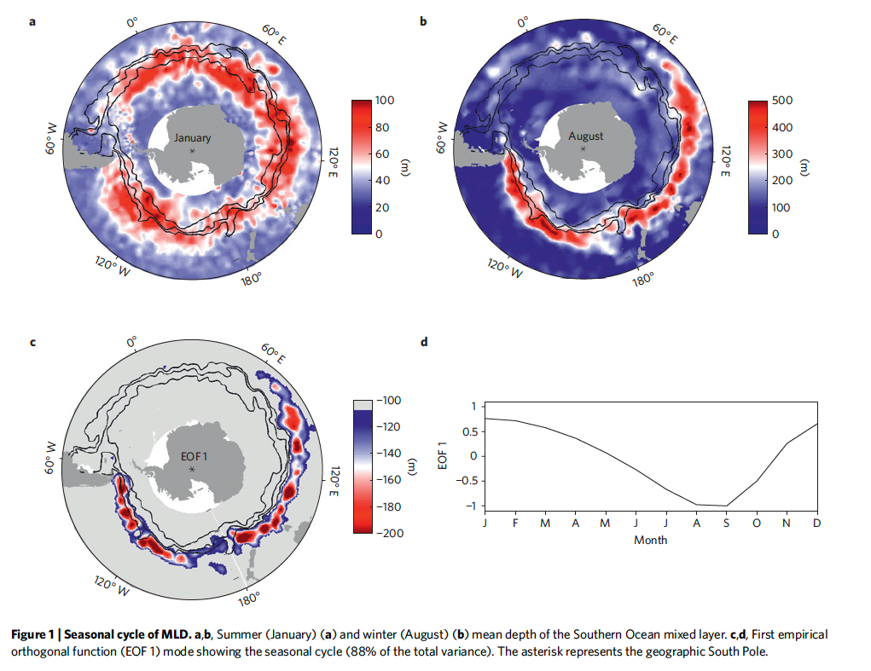
LOESS Method??
100 points
None greater than 1500 km

Slide 7
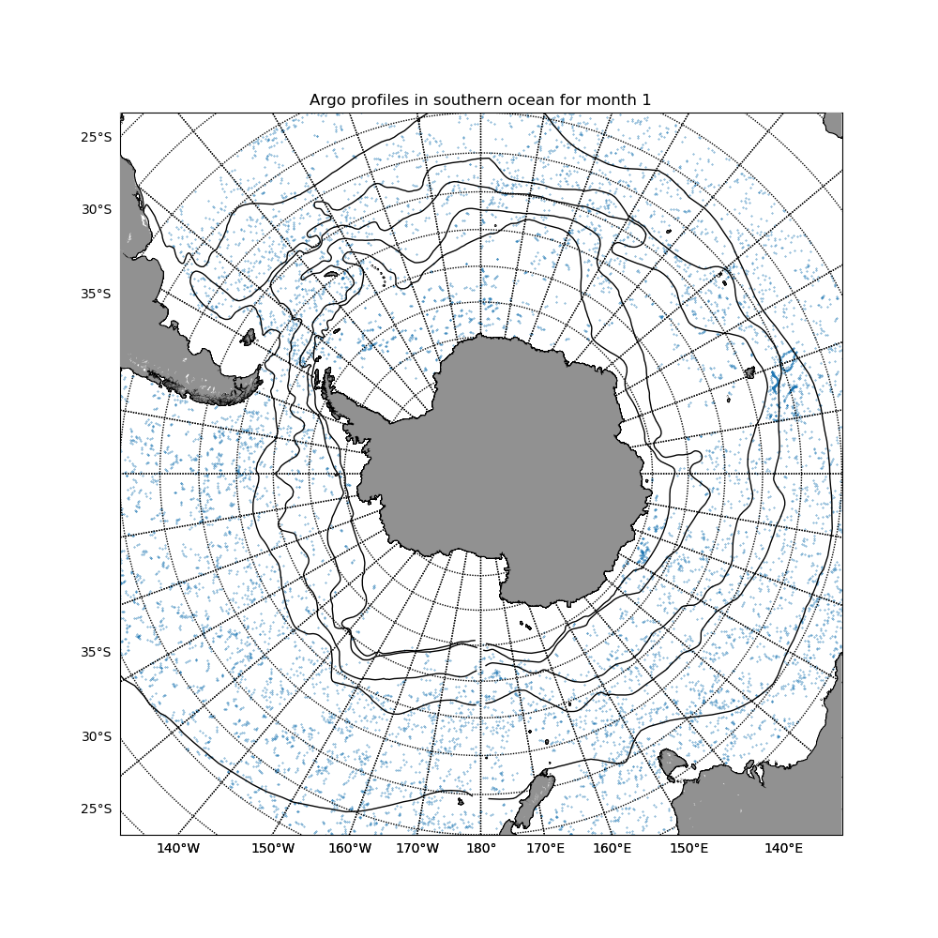
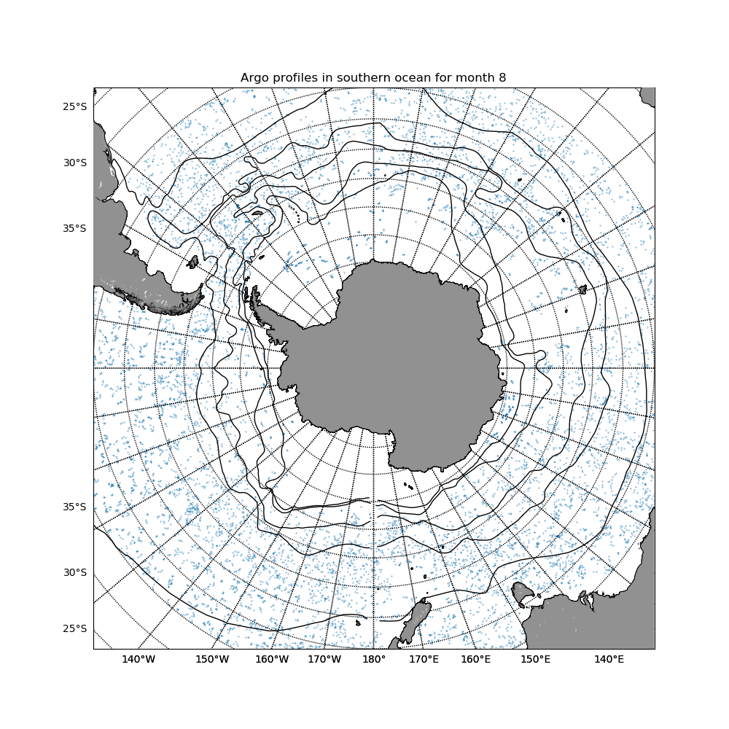
Data Density

Slide 8
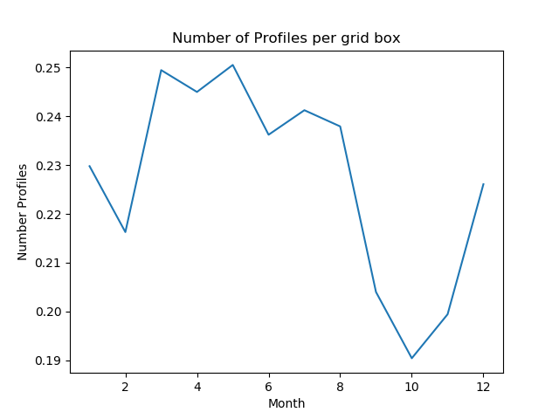
Data Density

Slide 9
I feel thin, sort of stretched, like butter scraped over too much bread
- Bilbo Baggins
Do we resolve the seasonal mean?
Is it misleading to construct an EOF that “constrains 88% of variance” when mapped fields may be artificially smoothed by paucity of data?

Slide 10
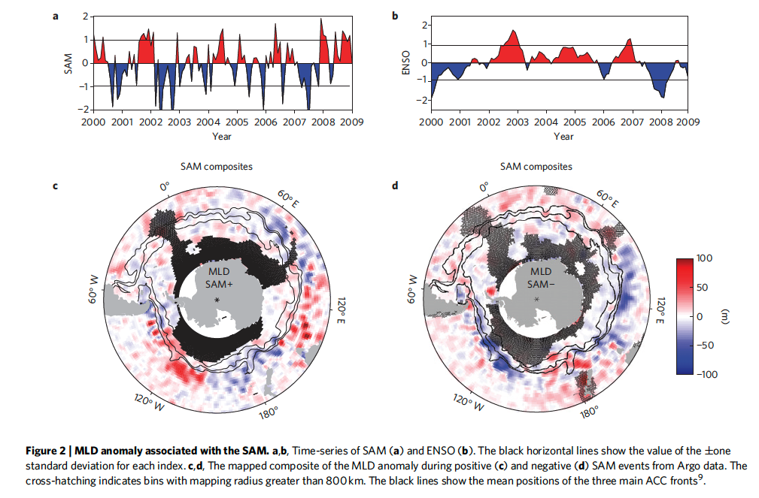
1

Slide 11
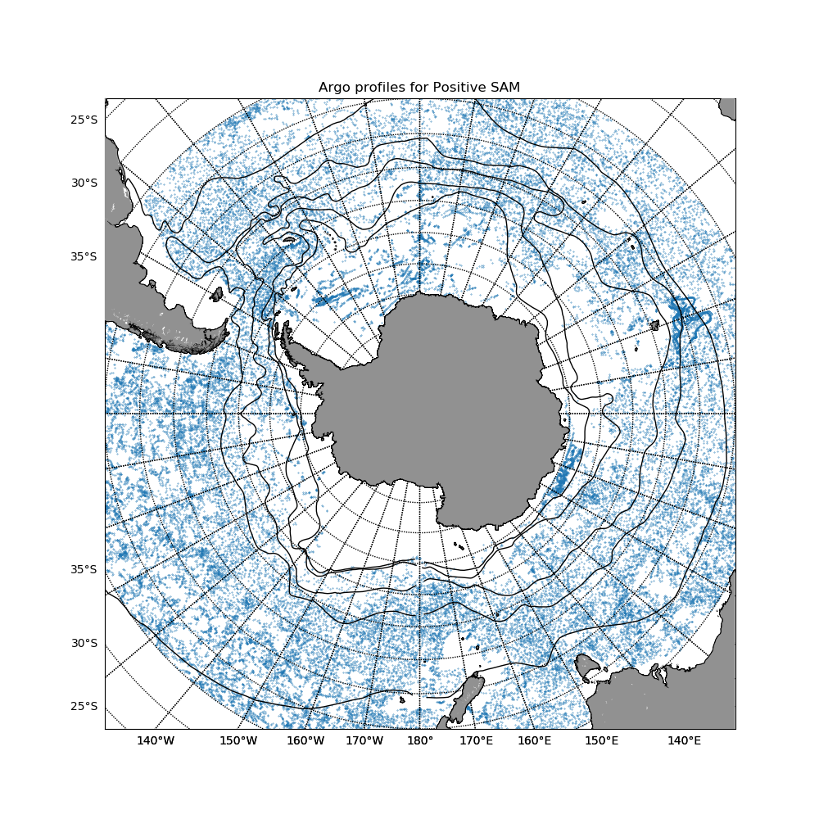
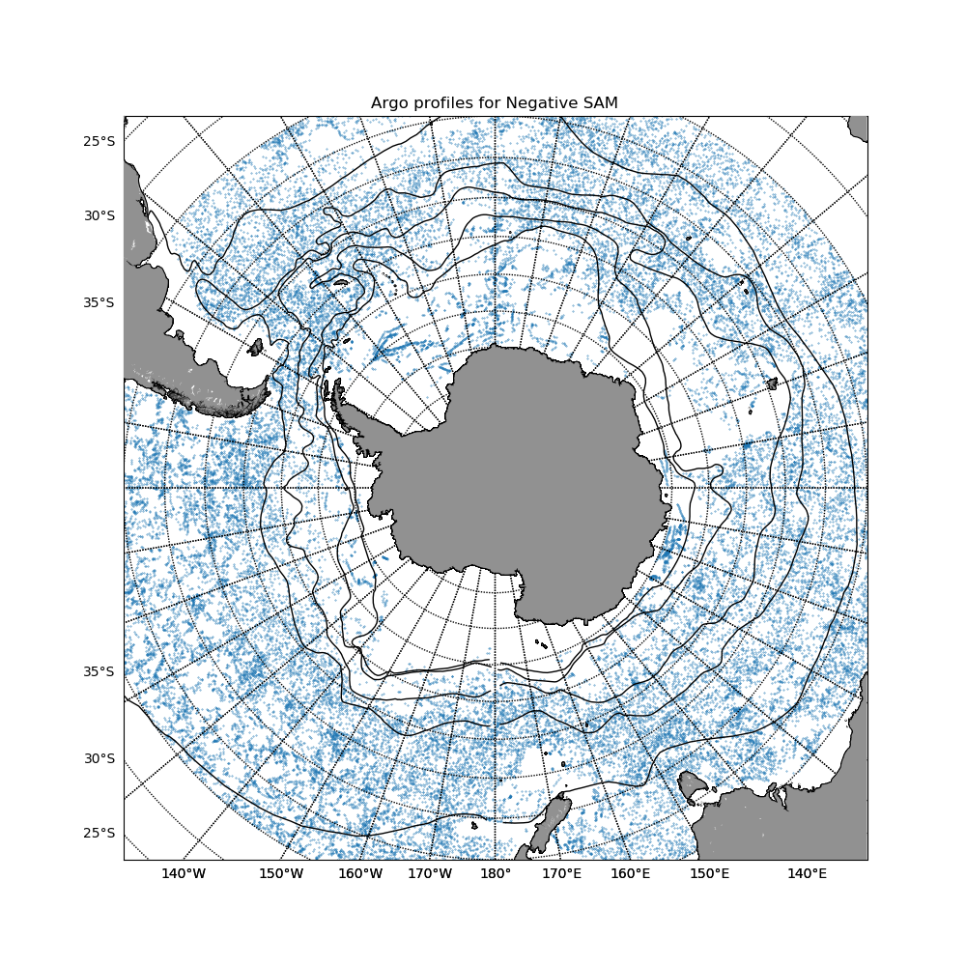
Data Density

Slide 12
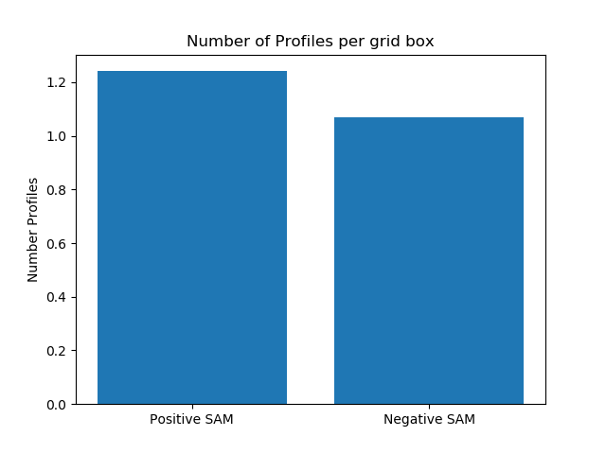
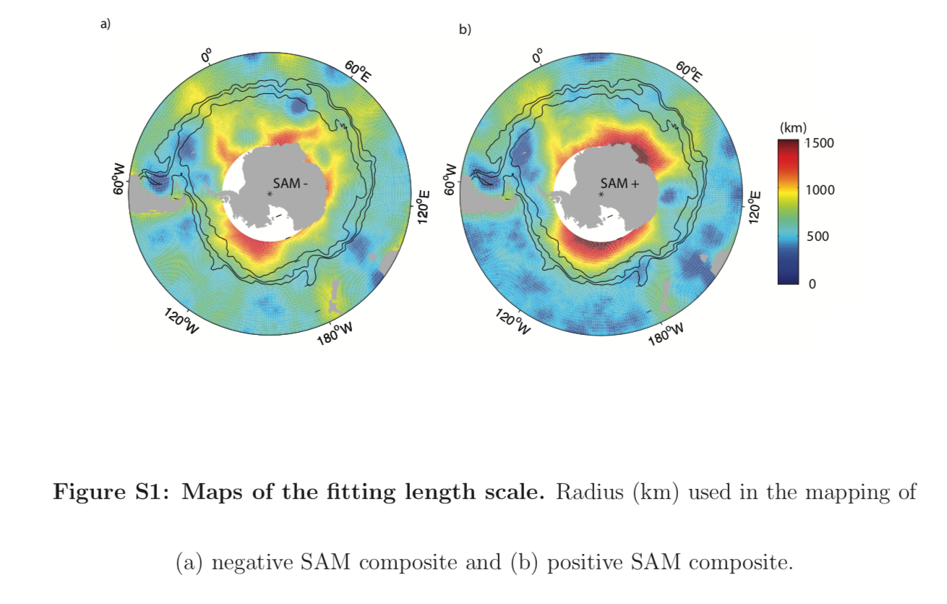
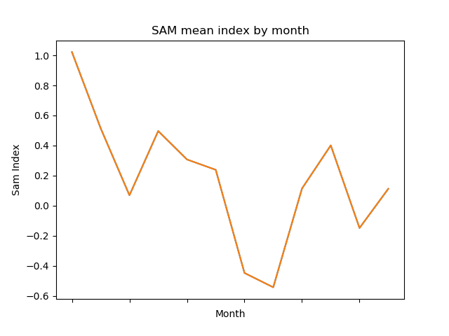
Data Density
Is seasonal cycle projected onto these results??

Slide 13

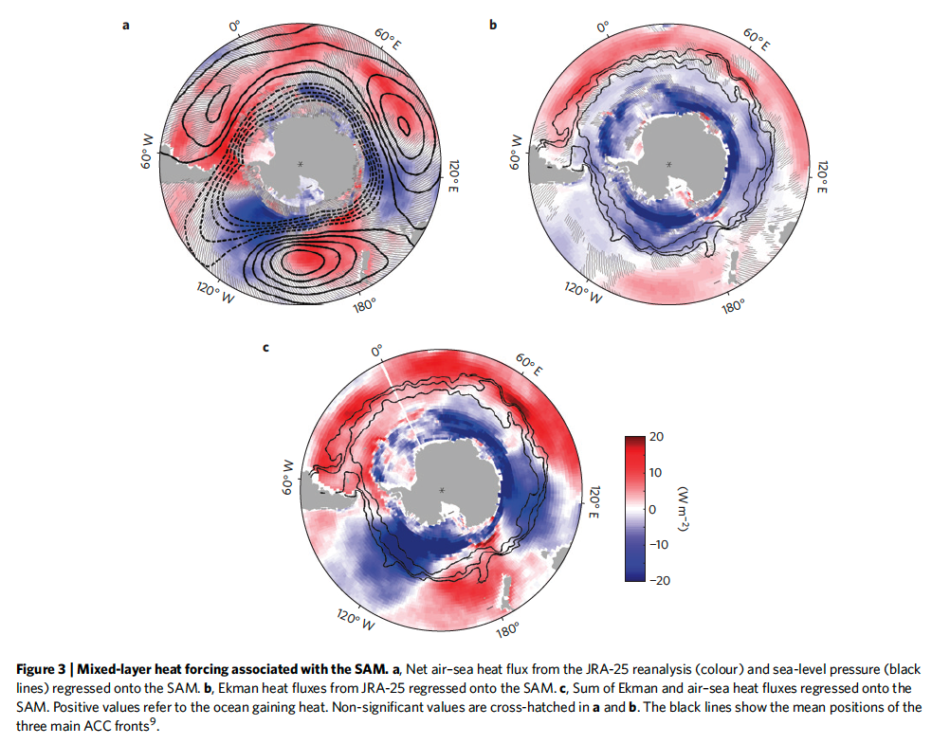
2
Air-sea Heat Flux
Ekman Heat Flux
Total Heat Flux
½ degree resolution
1-D model for MLD
Is MLD advection important?

Slide 14
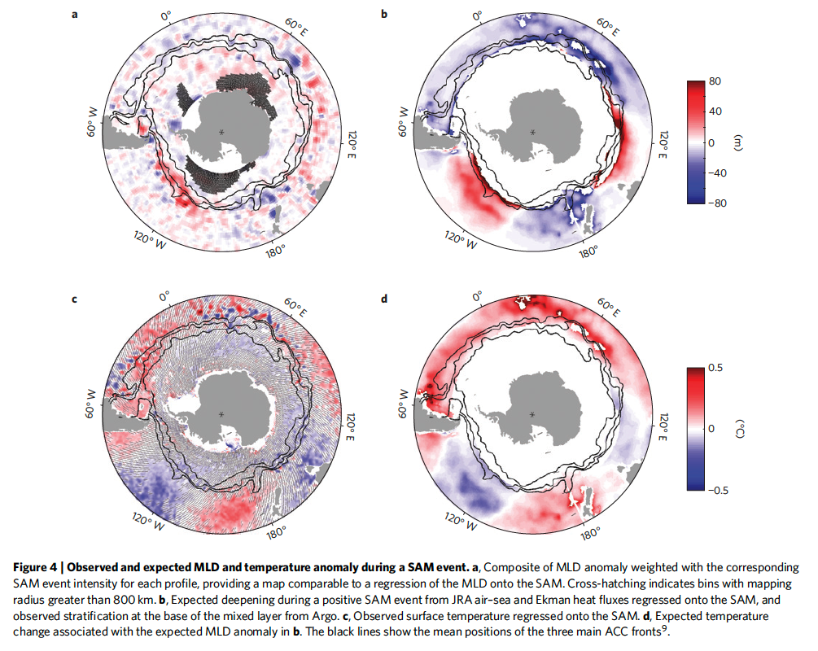
3

Slide 15
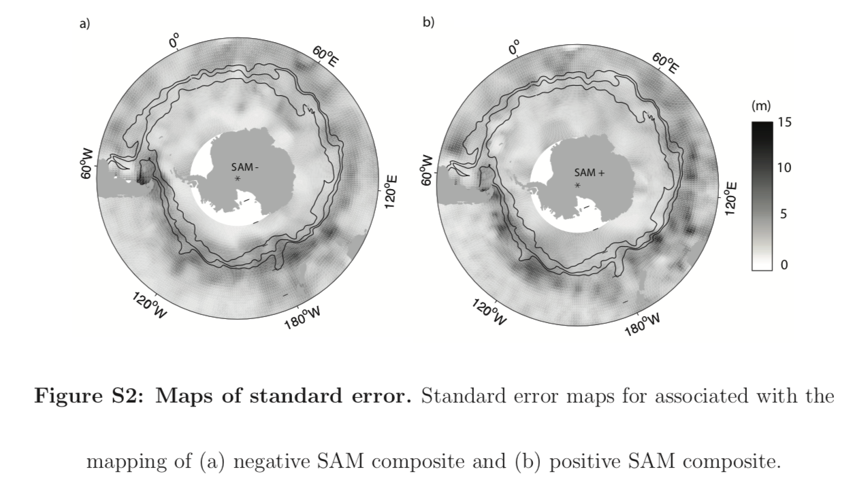
Meander in ACC forced by SAM?

Slide 16
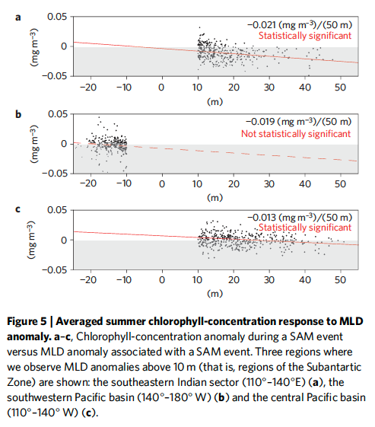
4
Any thoughts from those knowledgeable about satellites??

Slide 17
Summary
Argo MLD anomalies show asymmetric zonal structure during SAM events
Air-sea heat flux dominates over Ekman heat flux signal
MLD anomaly regressed to SAM has similar structure to heat flux anomaly regressed to SAM
MLD anomaly statistically significant predictor variable of chlorophyll anomaly during SAM event

